Slide 1




Ancestría Genética: Análisis de Componentes Principales
Genetic ancestry: Principal components analysis

Slide 2

Human evolution: isolation & diversification (99%)
African origin of modern Humans
0
Today
Time

Slide 3
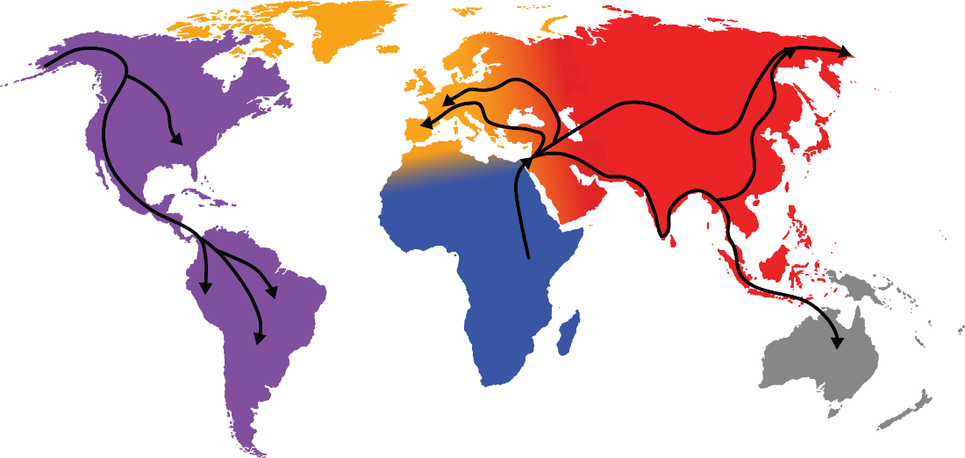
Human evolution: isolation & diversification (99%)
Isolation: migration out of Africa & formation of new populations
0
Today
Time
100,000-60,000 years

Slide 4
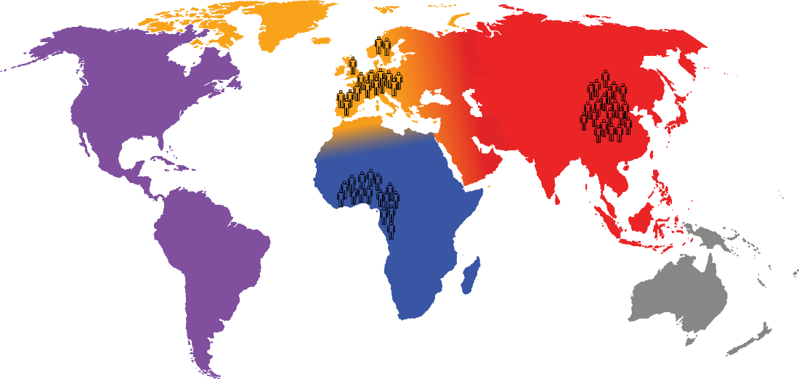
Human evolution: isolation & diversification (99%)
Diversification: accumulation of genetic differences between populations
This whole process works because human populations have had time to diverge
0
Today
Time
100,000-60,000 years

Slide 5
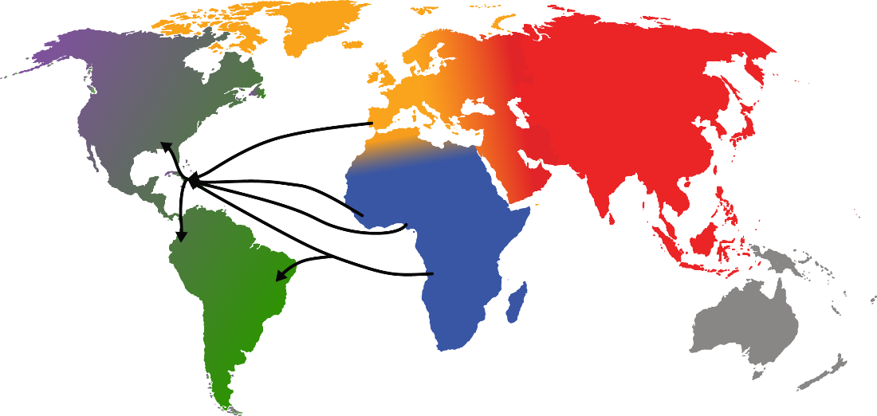
Human evolution: convergence & admixture (<1%)
Convergence of European, Native American & African populations
Genetic admixture between previously isolated populations
0
Today
Time
100,000-60,000 years
500 years

Slide 6



Human Evolution: Modern Era (last 500 years)
Technology has greatly reduced barriers to global travel and migration
Humans can and do move around the world with (relative) ease
This yields modern, cosmopolitan populations made of up of a mix of individuals from populations that were historically isolated
This may breakdown historical reproductive barriers (although culture can maintain them to some extent)

Slide 7
Ancestry inference is based on having known reference populations

Slide 8
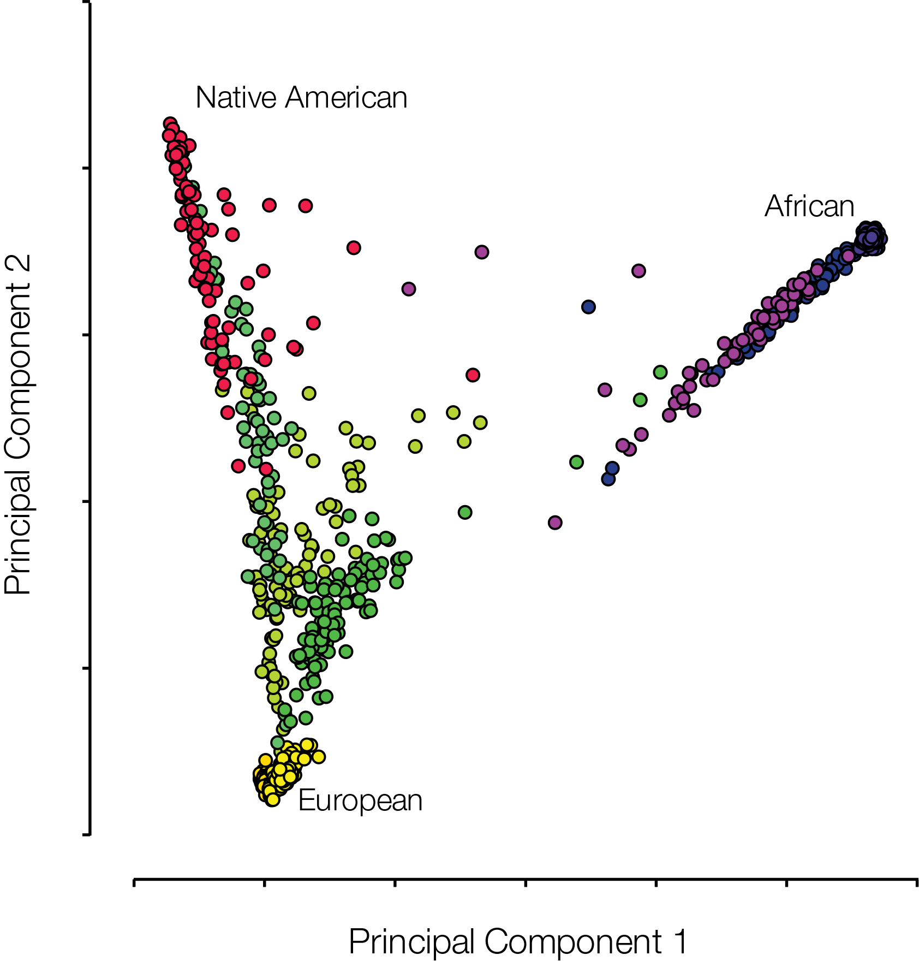
Principal Component Analysis (PCA)

Slide 9
Principal Component Analysis (PCA)
Genotype data is very highly-dimensional. We don’t have an x and y value in the data. We want to reduce the number of dimensions.
PCA works by rotating and transforming axes to generate a new set of uncorrelated “orthogonal coordinates” (axes that are at 90° to each other) ranked by the fraction of original variance they explain
The number of newer dimensions are at most the number of dimensions in the original data

Slide 10
Principal Component Analysis (PCA)

Slide 11
Principal Component Analysis (PCA)
The first axis of the PCA attempts to capture most of the diversity, followed by the second, then third, and so on
You hope to capture 90% of variation in the first two or three axes
The rest of the axes capture very little information and are generally not shown
Though they should be inspected before being discarded – at times they capture important biological differences missed by the first few axis

Slide 12
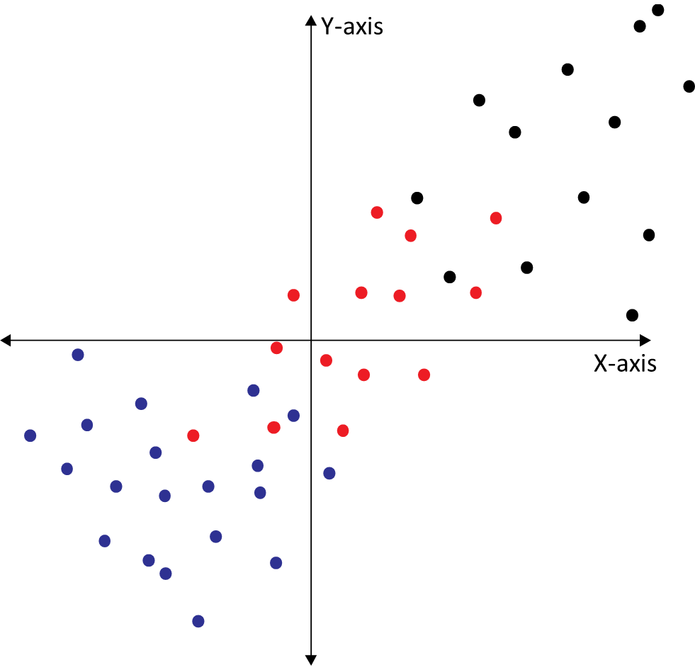
Principal Component Analysis (PCA)
PC1
Y-axis
PC2
PC1
Y-axis
PC2
Original Data
X-axis
X-axis

Slide 13
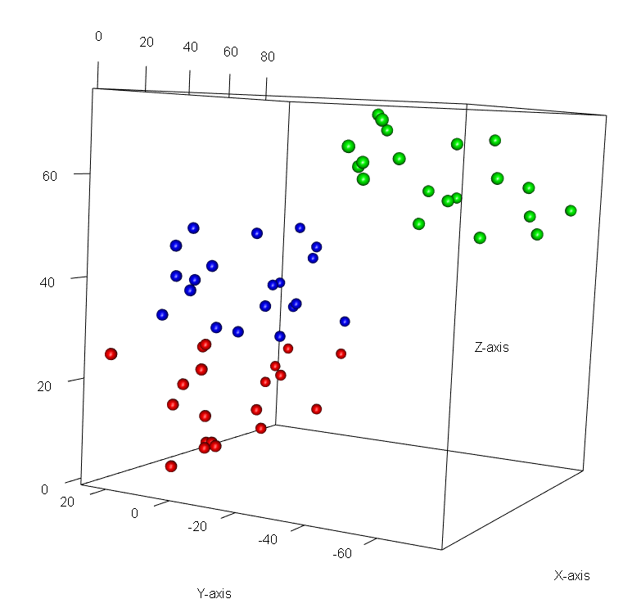
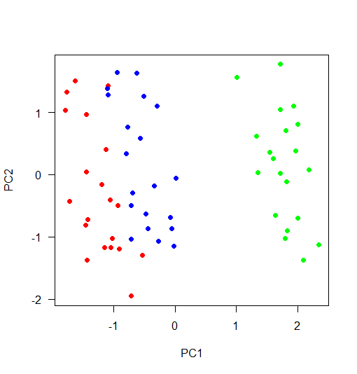
PCA in three dimensions

Slide 14
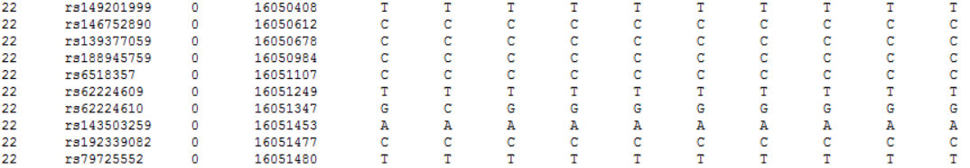
Our human genetic data is a big matrix of genotypes
Distance (in cM)
Base position
Chr
SNP id
Genotypes

Slide 15
Humans are diploid, each appears twice
Single individual (NA06984)
Single individual (NA06986)
Single individual (NA06989)
Single individual (NA06994)
Single individual (NA07000)
Distance (in cM)
Base position
Chr
SNP id

Slide 16
Principal Component Analysis (PCA)

Slide 17
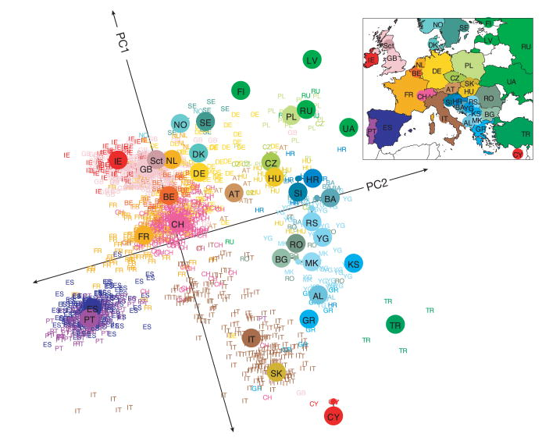
Subcontinental Ancestry
Novembre et al. (2008) Genes mirror geography within Europe. Nature 456: 98
Figure 1. a A statistical summary of genetic data from 1,387 Europeans based on principal component axis one (PC1) and axis two (PC2). Small coloured labels represent individuals and large coloured points represent median PC1 and PC2 values for each country. The inset map provides a key to the labels. The PC axes are rotated to emphasize the similarity to the geographic map of Europe.

Slide 18
Additional resources
https://builtin.com/data-science/step-step-explanation-principal-component-analysis
https://www.nature.com/articles/ng0508-491

